Slide 1
Welcome to all 2024 Parents and Carers

Slide 2
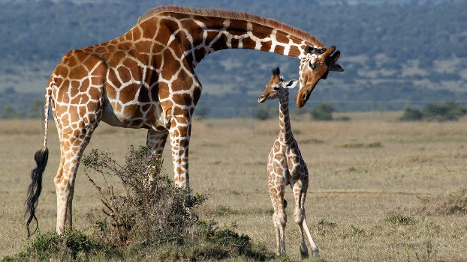
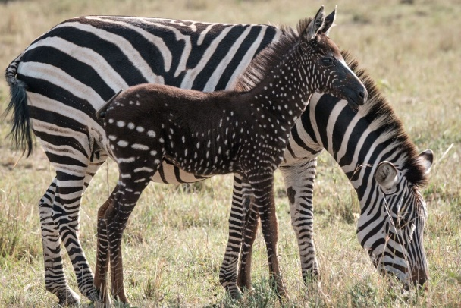
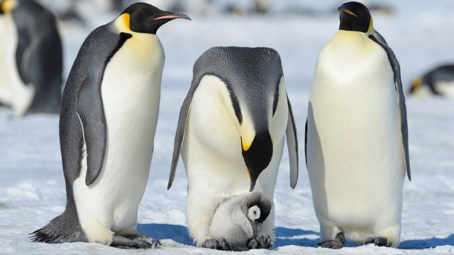
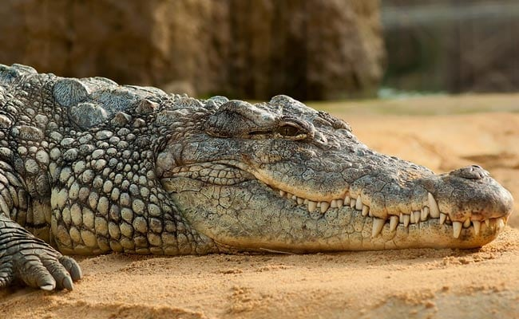
Start of the day
The school day begins at 8.40am and finishes at 3.15pm. The children start with full-time days from day one.
Staff greet you and your child at the main door and from there the children go straight to their Keyworker group area, unpack their bag, collect their name card and place it on the board to self register.
Children then go to their class area to be registered by their teacher. During this time they also have the opportunity to quiet read or try writing a sentence about a picture on the interactive whiteboard.

Slide 3
An example of a daily timetable
8.45am – Welcome
Calendar, Word of the Day, funky fingers and dance
9.30am - Phonics
10.00am - Water and Toilet break
10.15am – Outdoor Playtime
10.30 – Snack and Communication and Language
10.45am - Child-Initiated Play
11.30am – Tidy up and prepare for lunch
11.45am - Lunch and playtime
12.50pm – Registration, toilet, drink and story
1.10pm - Maths
1.40pm – Skills Group Activity
2.00pm - Child-Initiated Play/Continuous Provision
Water and Toilet break
3.00pm – Preparation for end-of-day and singing practice.
3.15pm - Home

Slide 4
Phonics
Children work for 20/30 minutes in their phonics carousel groups. They may be working with their class teacher using the IWB and the school Phonics programme learning new sounds, or they will work with a TA in the carousel where they are consolidating their learning through reading, writing and fun interactive games.

Slide 5
Communication and Language/Literacy Whole Class Teacher-Led
Communication and language sessions are usually focused upon class topics and give your child opportunities to share and discuss their ideas and focus on building your child’s confidence and communication skills throughout the year. Class topics and themes are usually derived from the children’s interests, as well as making sure we are covering areas of the Early Years Curriculum and celebrating important times throughout the year.

Slide 6
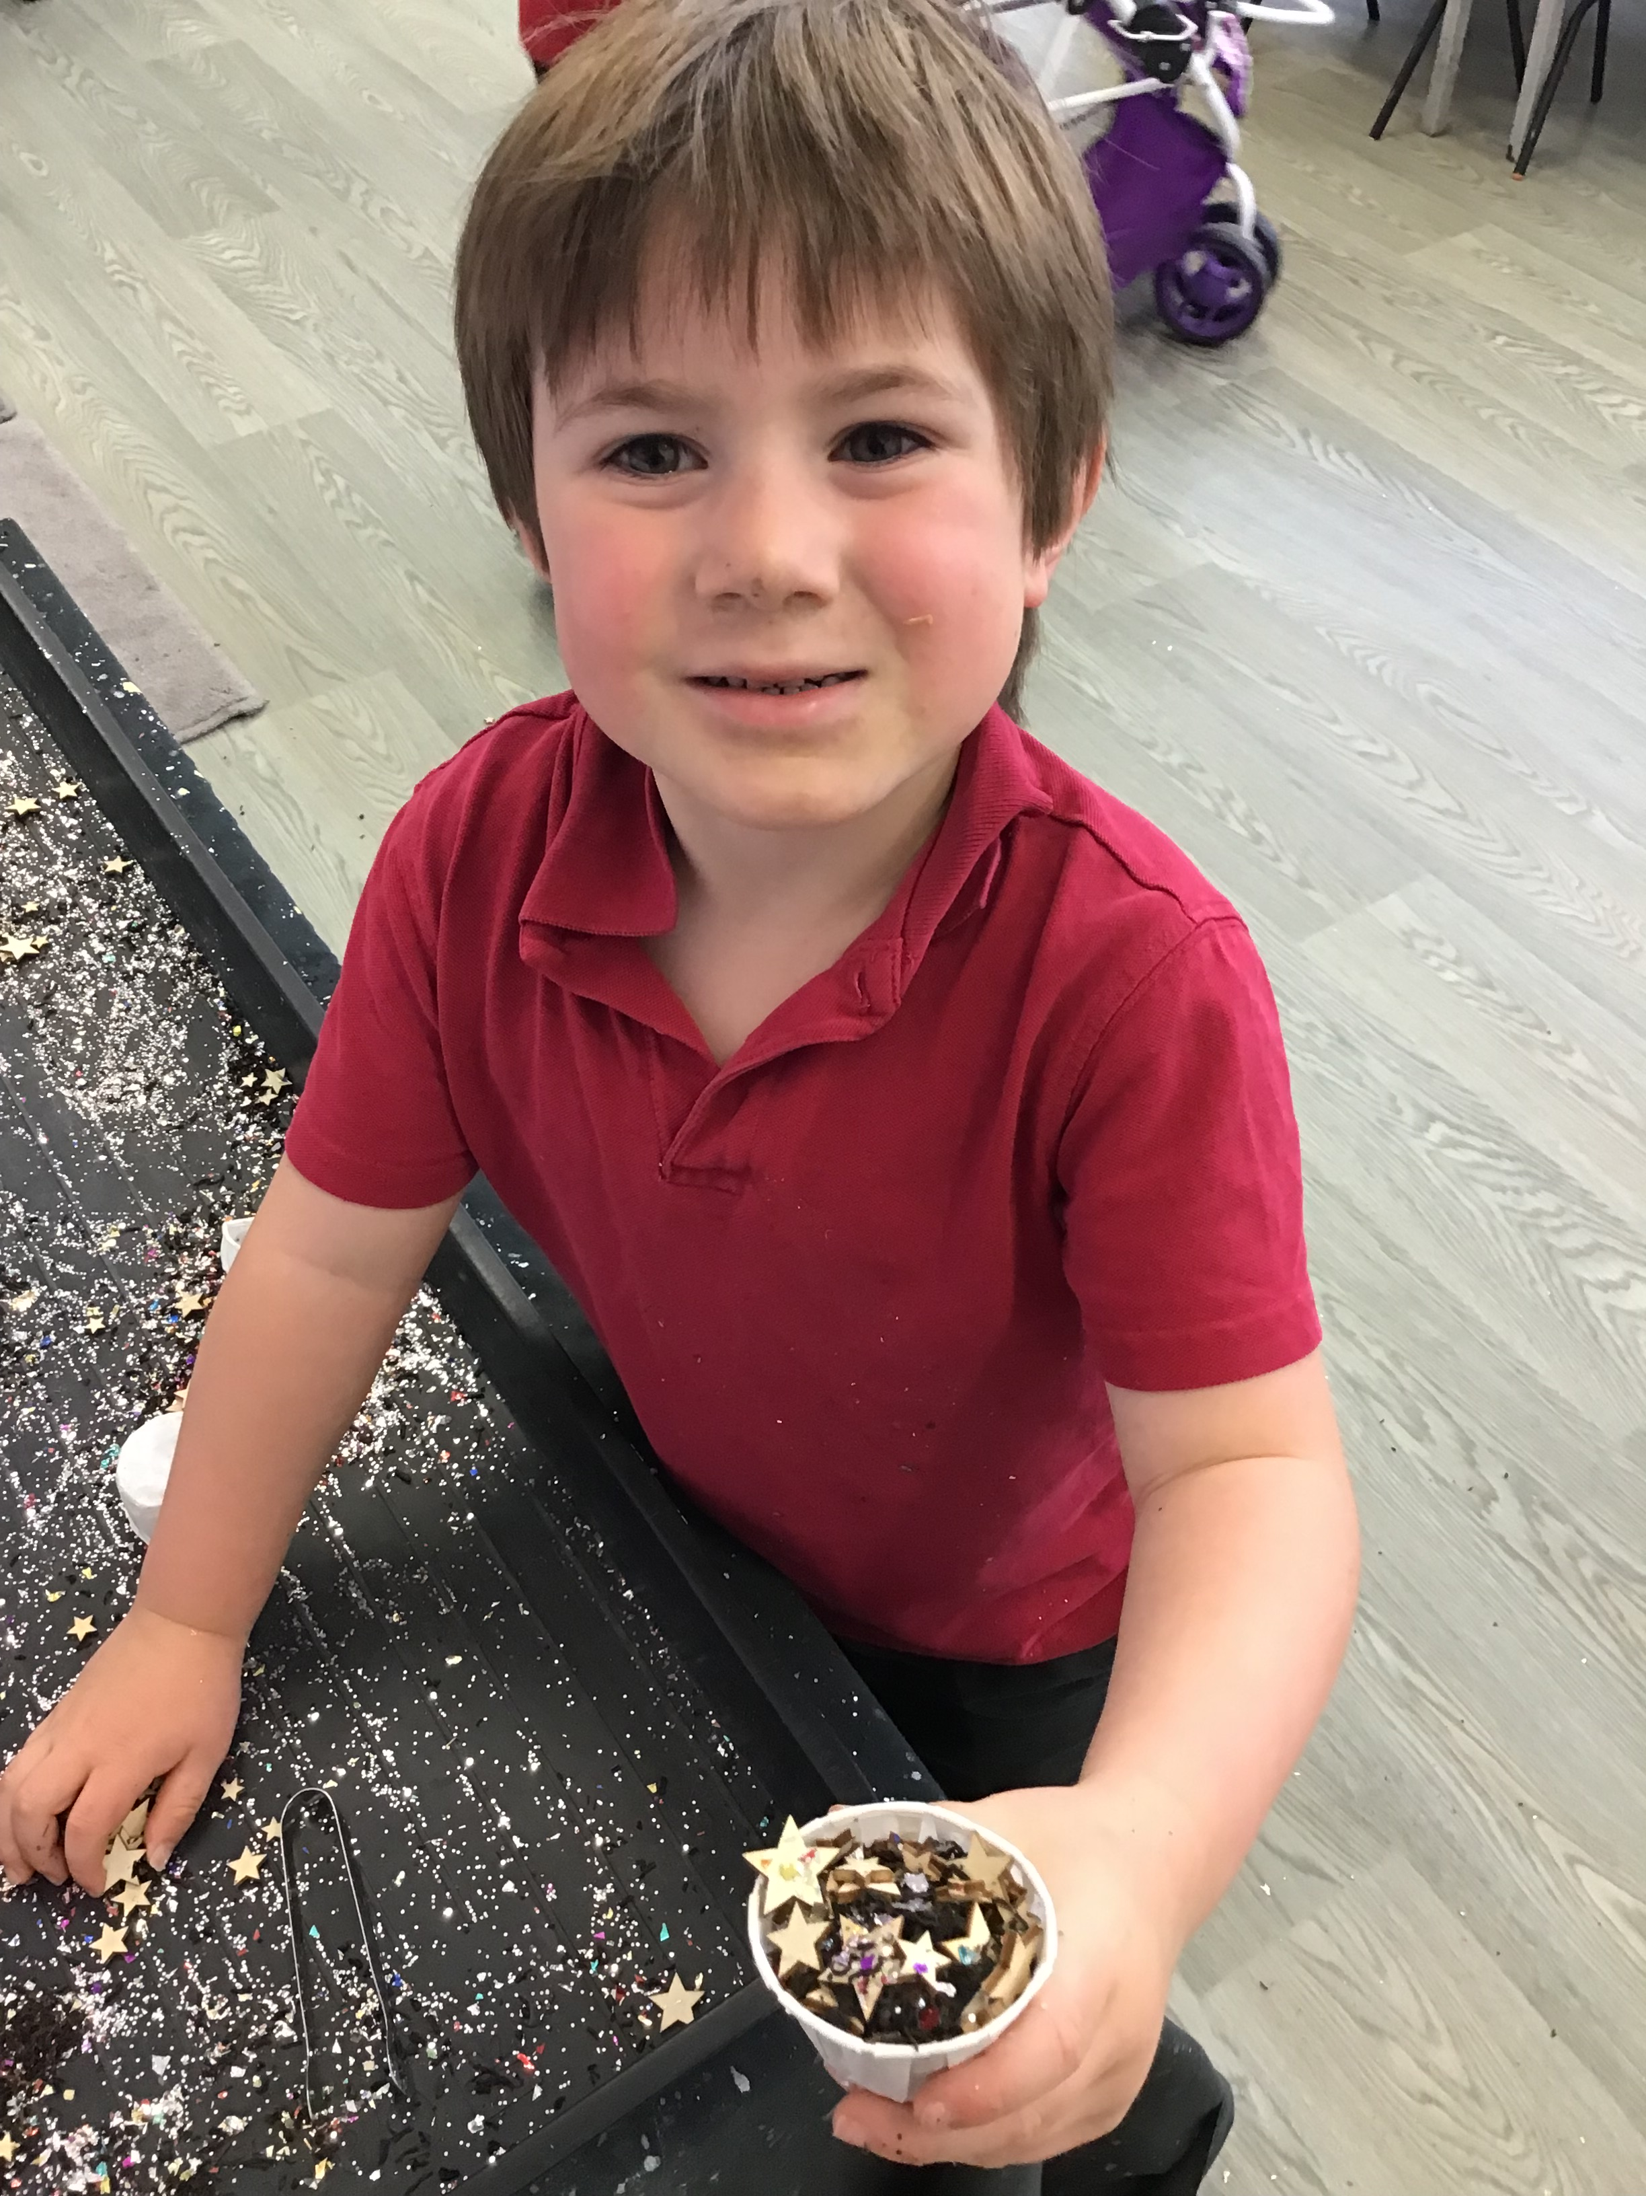
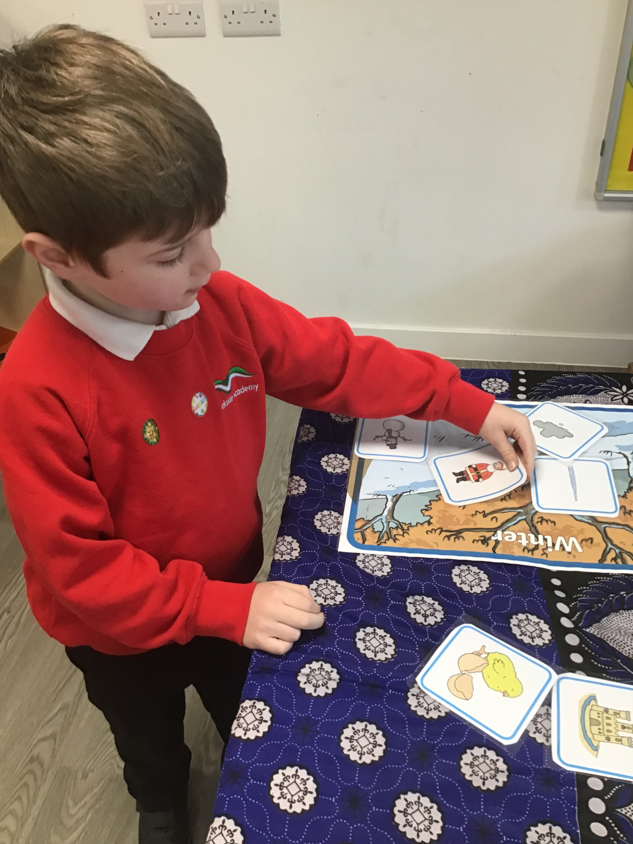
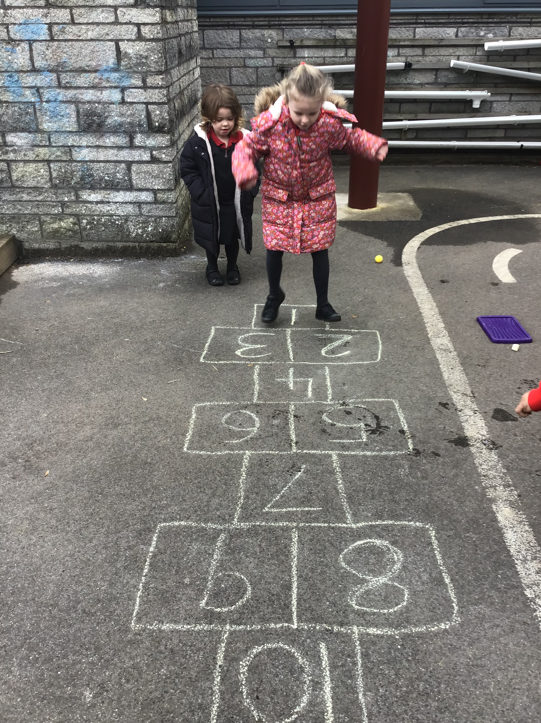
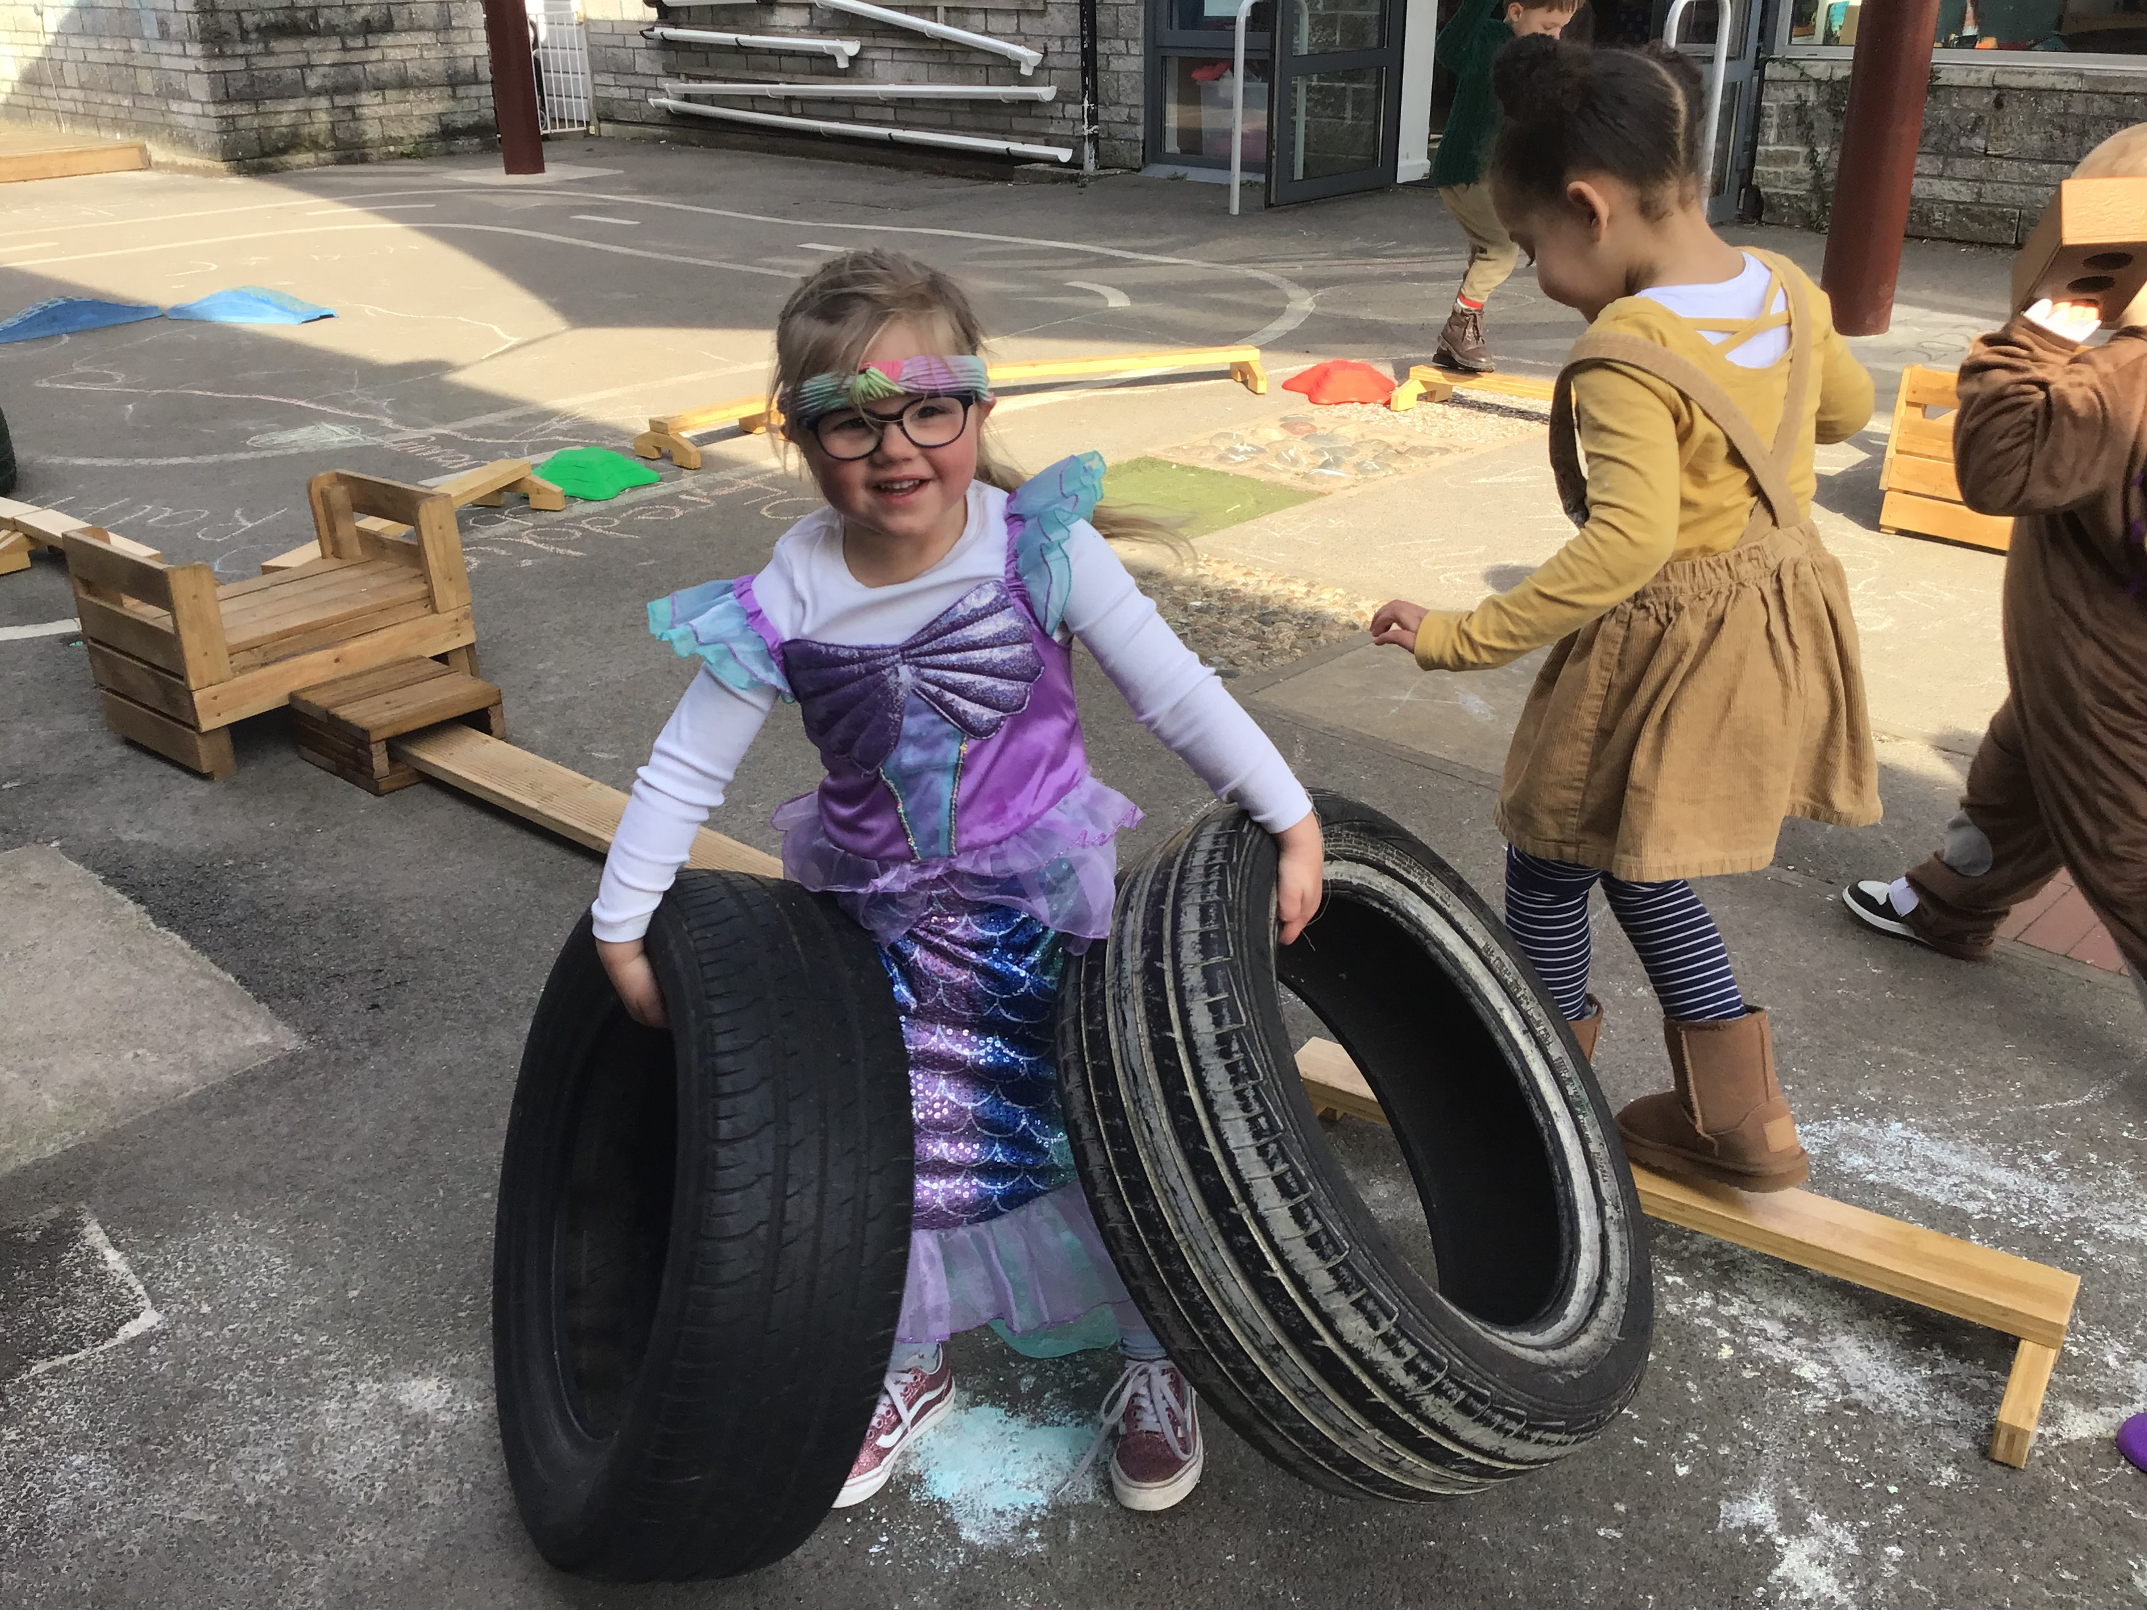
Child-Initiated Play
During this time we have lots of areas set up ready for the children to use, as well as leaving resources available for the children to decide what they wish to use. Our areas are set up to compliment your child’s interests, alongside supporting them in progressing through the Early Years curriculum. We offer free flow between indoors and outdoors, allowing your child opportunities to practice and develop a variety of skills using different equipment.

Slide 7
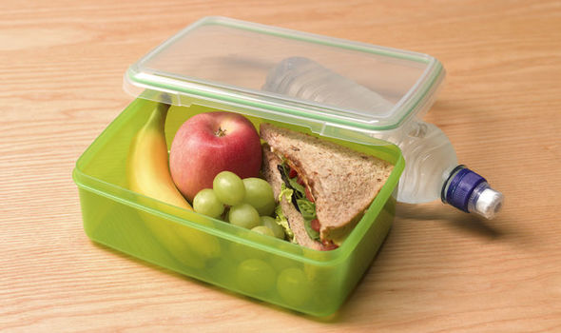
Lunchtime 11.45am – 12.50pm
All children in Early years through to Year 2 are entitled to a free school meal. Most children do choose to have a cooked lunch every day. The menu is given out monthly for parents information, you must fill in your child’s selections online for the days you wish for them to have a cooked meal. This must be booked two weeks in advance.

Slide 8
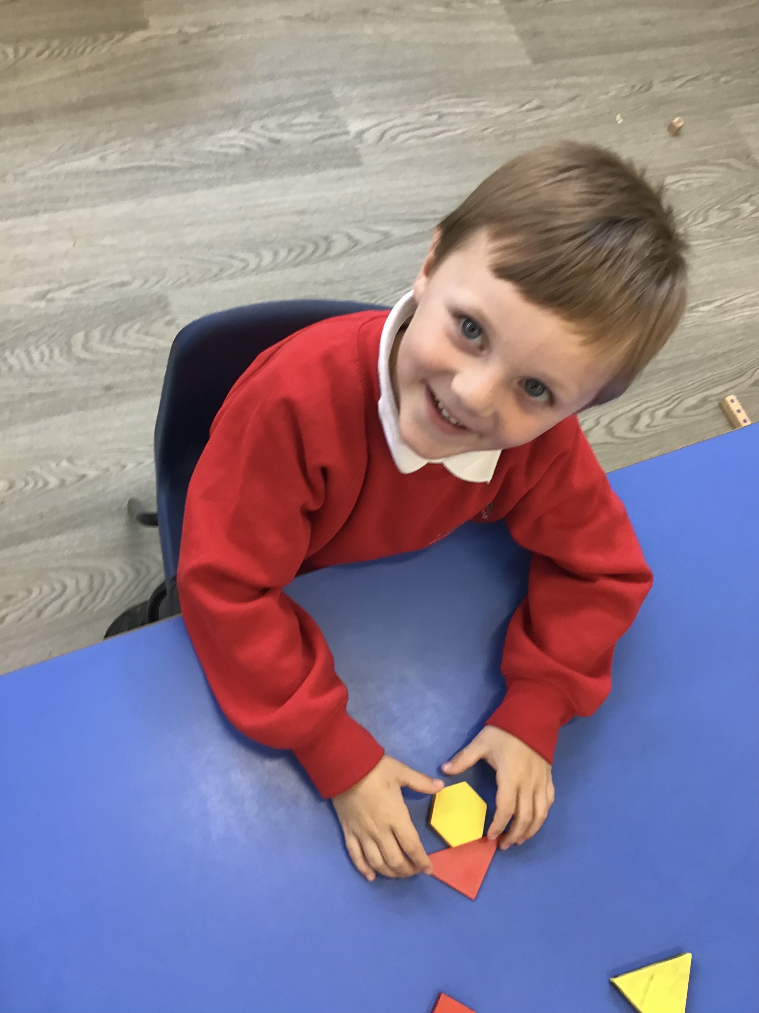
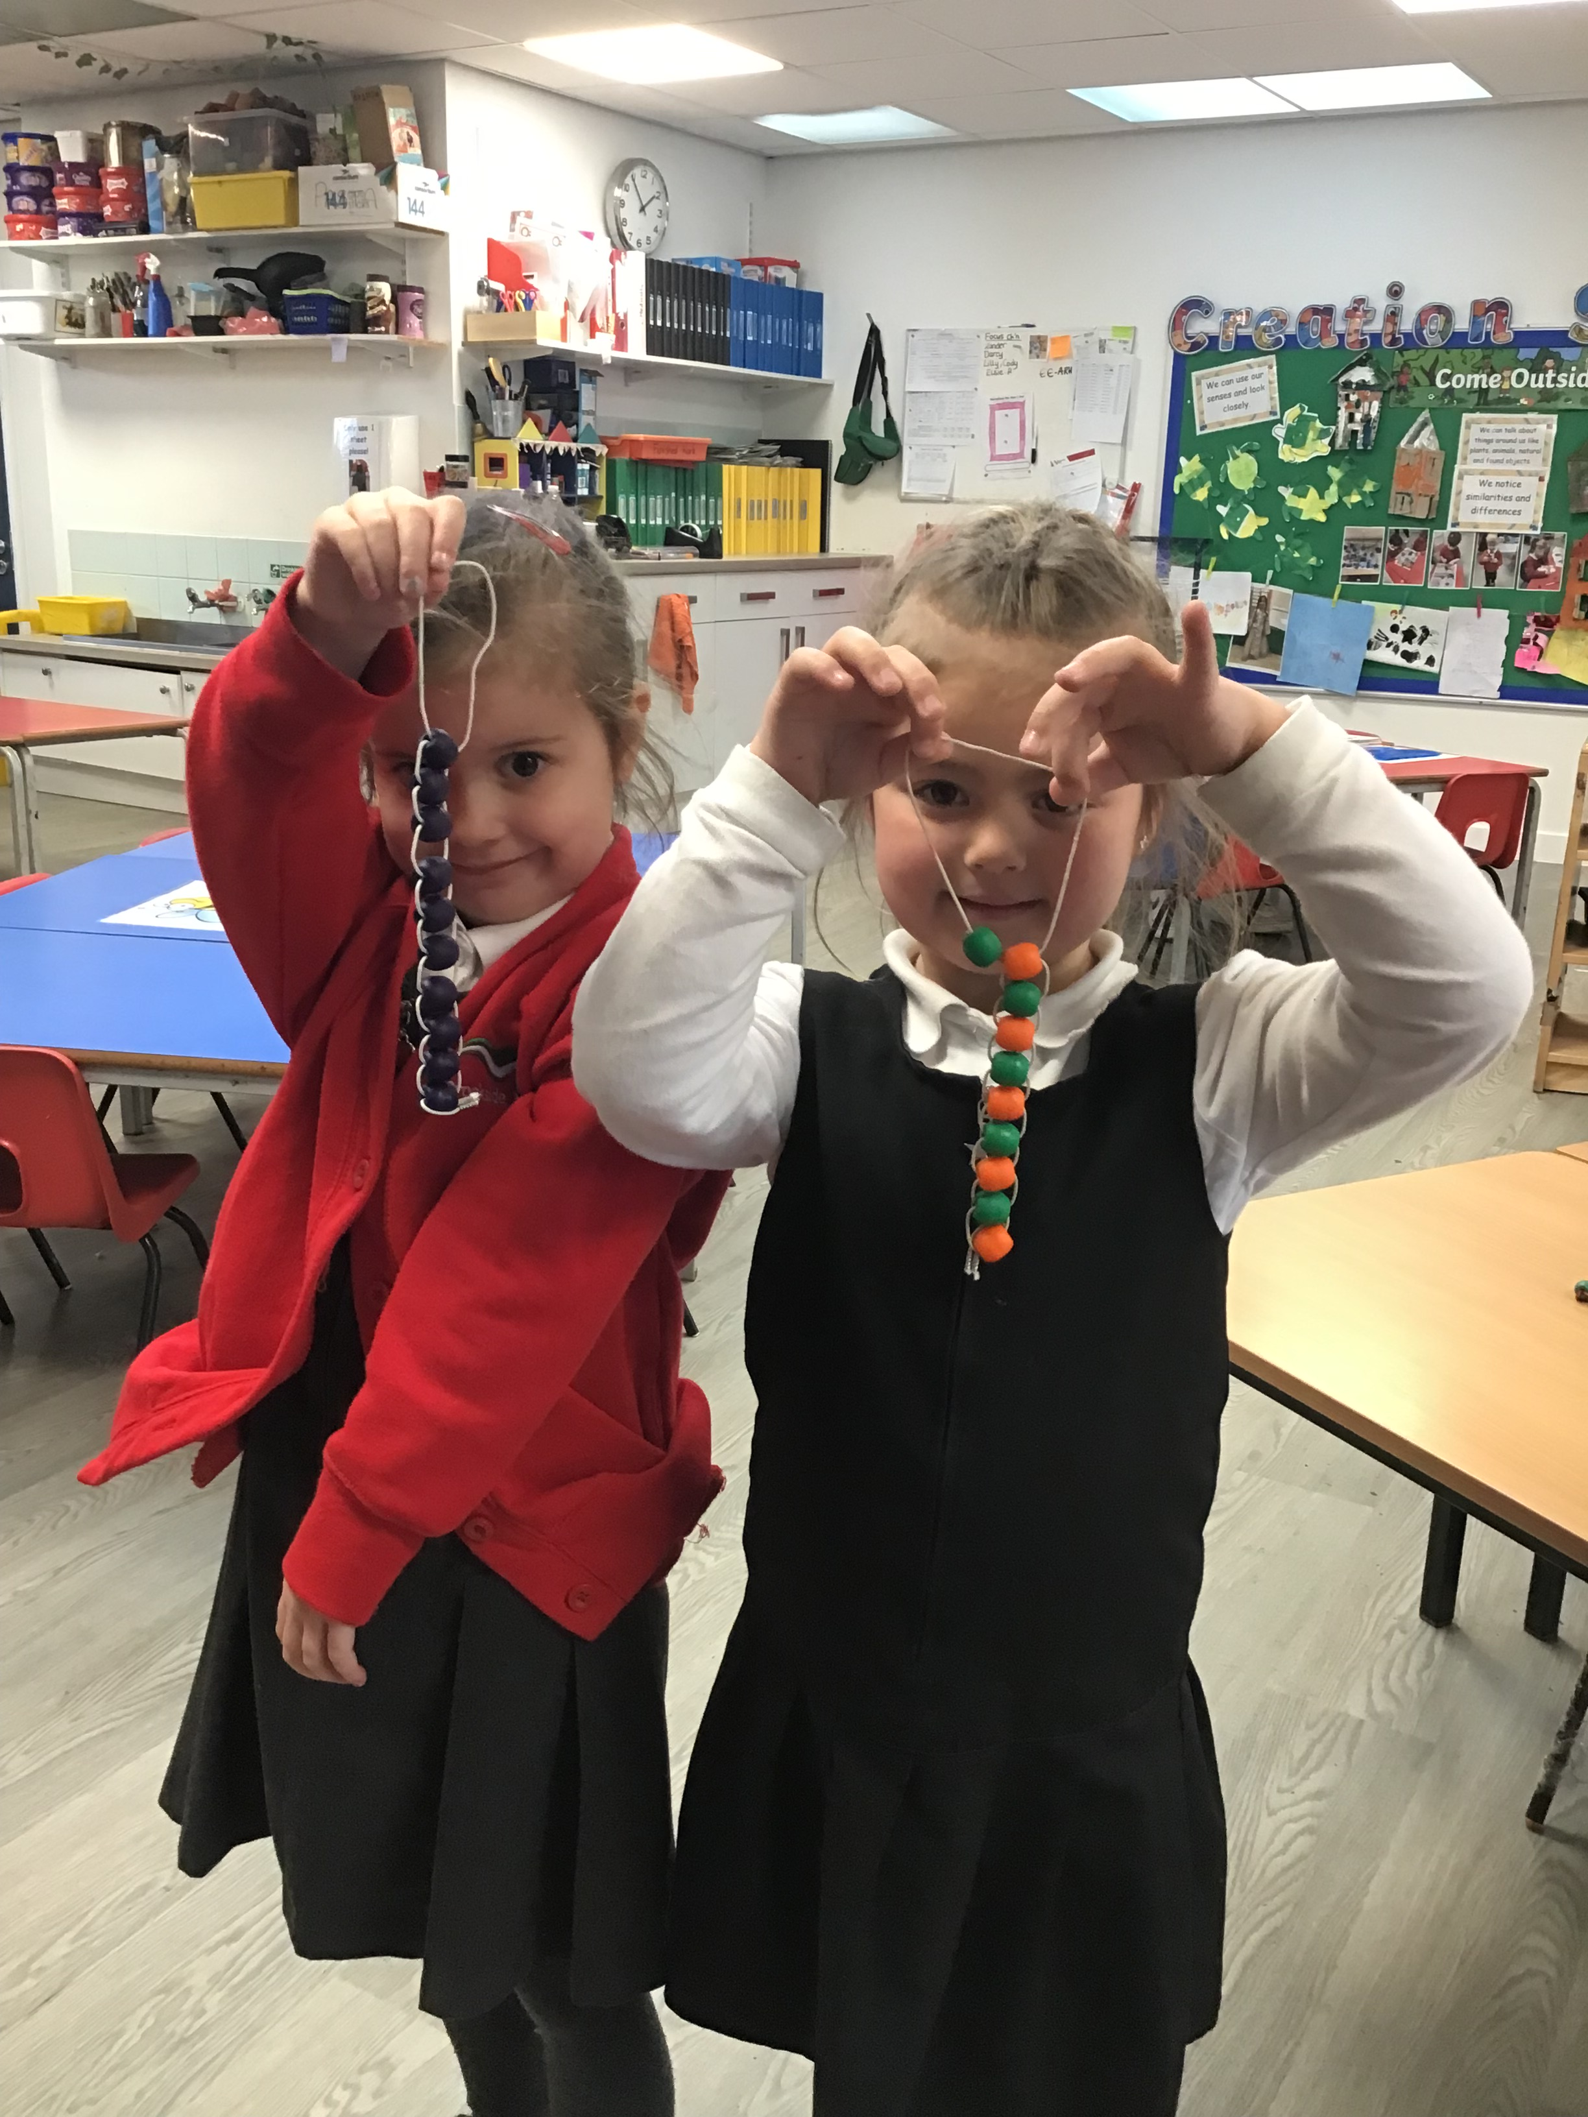
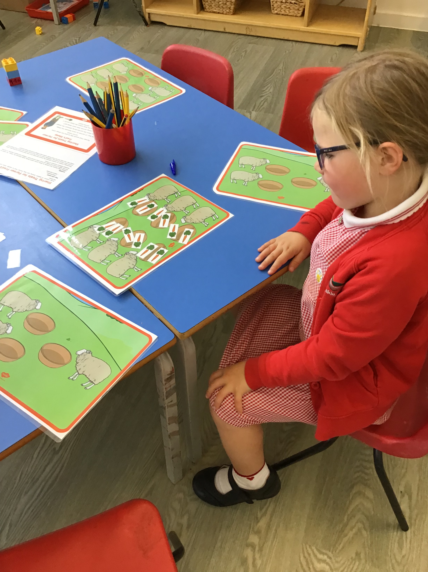
Maths
The children have daily whole-class starters and lesson input in Maths with their teacher.
The children then work with either a teacher or a key person experiencing a range of mathematical activities across the week.
We plan for these activities to be indoors and outdoors and work in small groups to give your child lots of opportunities to fully engage.
Consolidation activities are available in continuous provision.

Slide 9
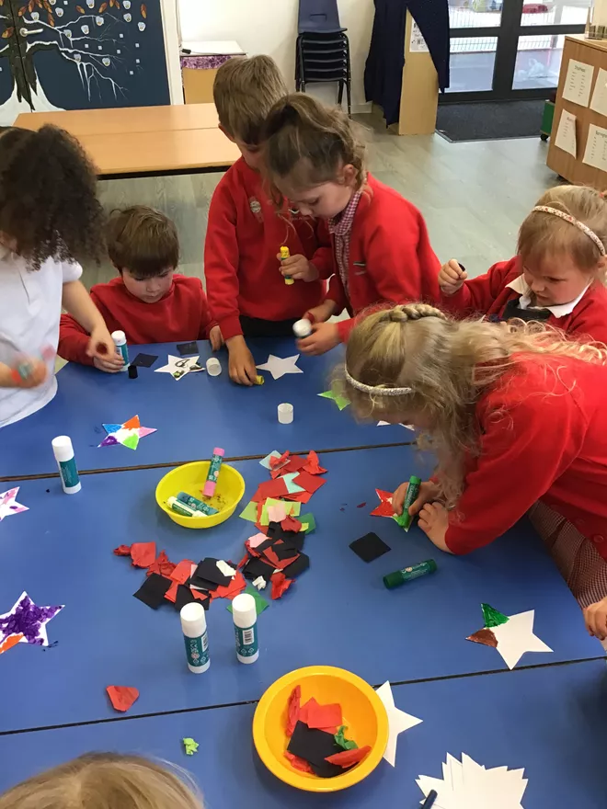
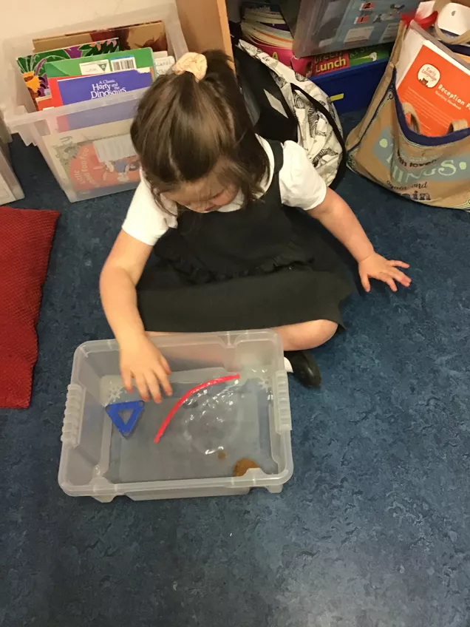
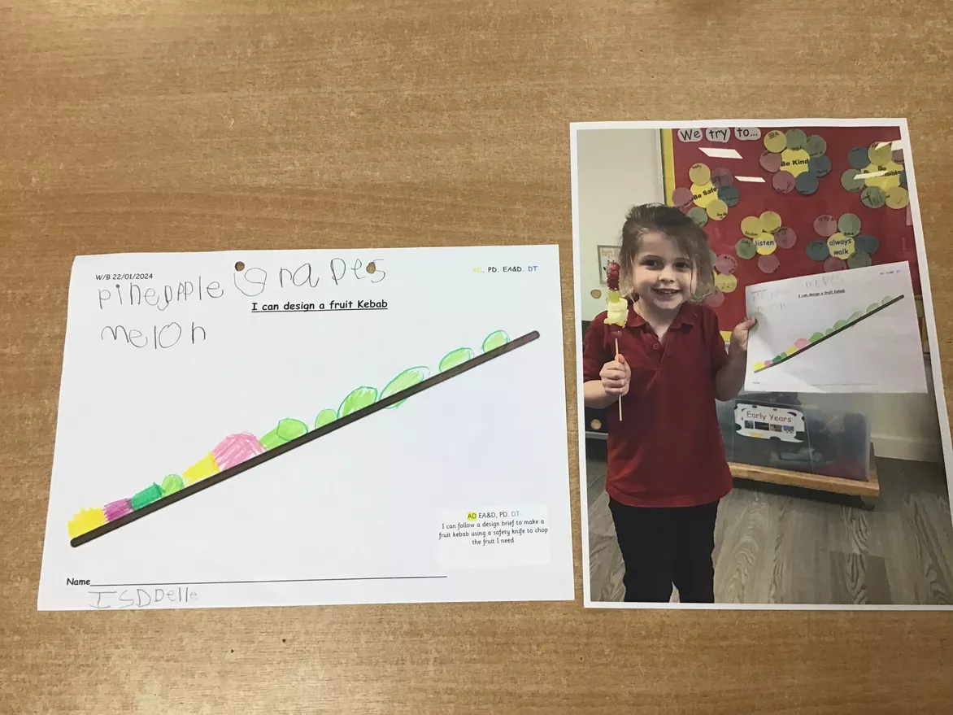
Skills Groups
Each week the children participate in a carousel of skills-based activities, lead by each member of the team.
This includes learning across areas covered in the National Curriculum such as Geography, DT, History and may also include activities such as Art, Music, Handwriting, Yoga, Real PE sessions, Using Technology e.g. remote control vehicles and other activities based on the children’s interests.

Slide 10
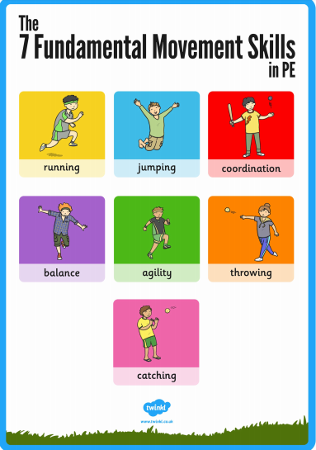
Sport with PE Leaders
Once a week your child will go to sport with our PE Leaders.
All children will need to have appropriate, clearly named P.E kit for both warmer and cooler weathers. Trainers are suitable for both indoors and outdoors.
They are required to change themselves. We obviously support to begin with but they become more independent as the year progresses.

Slide 11
OPAL Outdoor Play and Learning
Children spend some time at Lunchtime playing in different areas of our whole-school outdoor provision.
The children can keep a clearly named water proof rain mac and a pair of named wellies in the classroom if they wish.
Our Early Years Key workers are on duty at lunchtime so the children have a familiar face if they need help or support at this time.

Slide 12
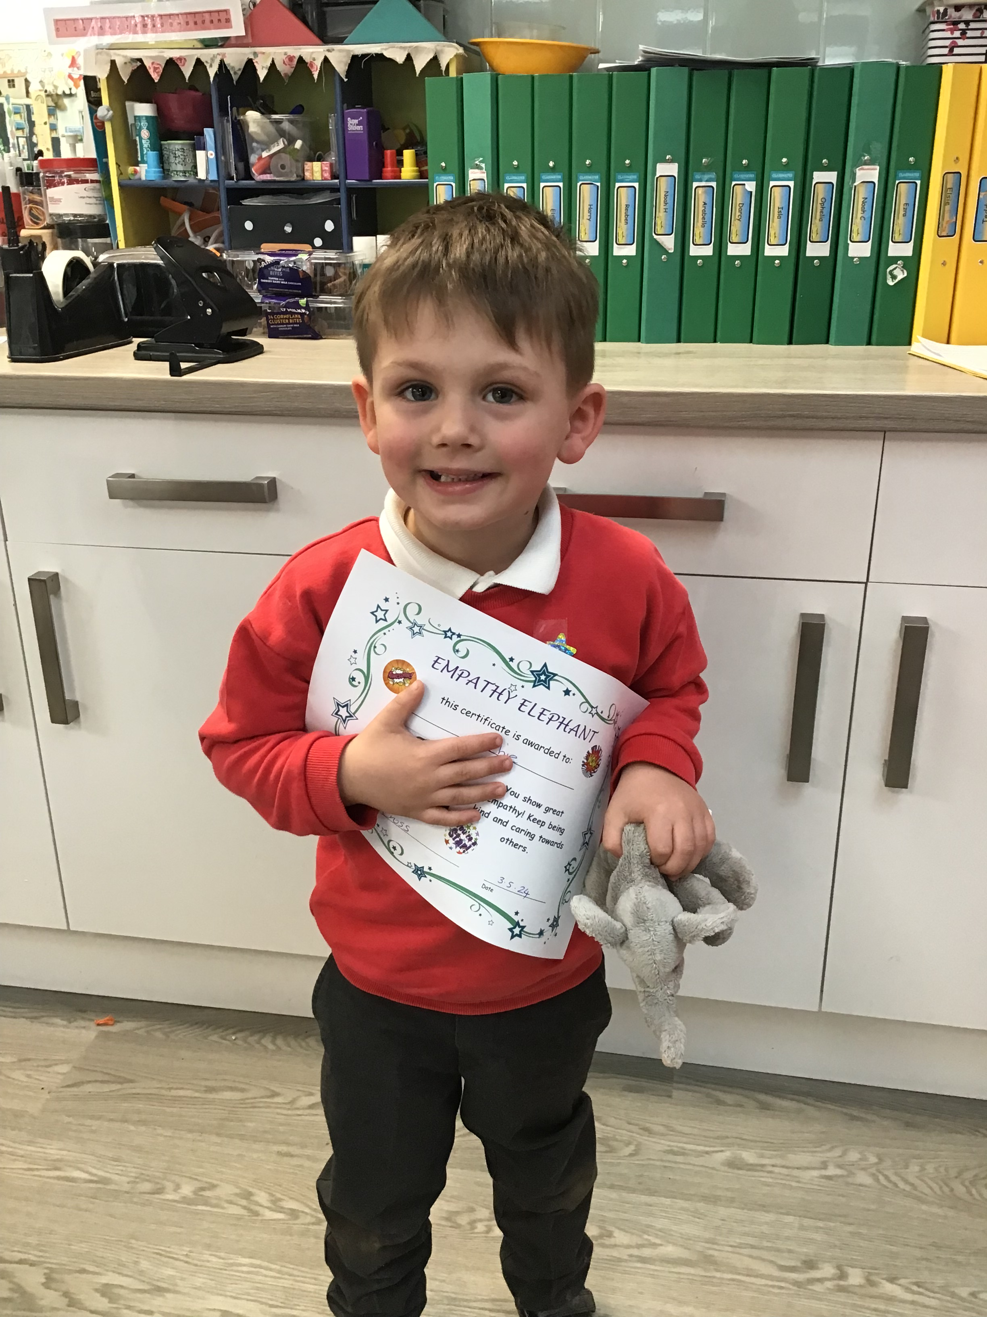
Celebrations
Every Friday afternoon we have in-class assembly to celebrate children’s achievements and successes from the week. Children are chosen by each adult in the class to receive a Superstar award.
We also have 4 wonderful class toy animals who are presented to chosen children showing certain skills throughout the week. For example, showing resilience when something is tricky. The children can enjoy playing with the toy animal for the remainder of the afternoon.
There are 2 Celebration certificates that are awarded in line with the rest of the school.

Slide 13
Useful information
Early Years staff will be on the door to greet you at drop off and collection. The Early Years door is the first door on the left as you walk down the path to Nursery.
Please ensure your child brings a clearly named, refillable water bottle to school each day. They will have access to this throughout the day.
Please ensure your child has a clearly named PE kit in school at all times. We usually keep PE kits on children’s pegs for a half term and then send home to be washed.
Please ensure that all children’s clothing is clearly named. It is very easy for items to get mixed up when the children are changing for PE.
Over the Summer, please help your child to develop skills of independence with getting dressed and undressed (this helps with PE), putting on and taking off jumpers/cardigans and coats, managing own toileting needs and good handwashing technique.
Other questions or information- please talk to us tonight or e-mail into the office.

